Slide 2
Why Home Networking?
Cable Modems
  U.S. - 2.9M in 2000 → 12.4M in 2003
  Worldwide - 5M in 2000 → 24M in 2003
Digital Subscriber Lines
  U.S. - 1.75M in 2000 → 13.9M in 2003
  Worldwide - 4.4M in 2000 → 36.1M in 2003

Slide 5
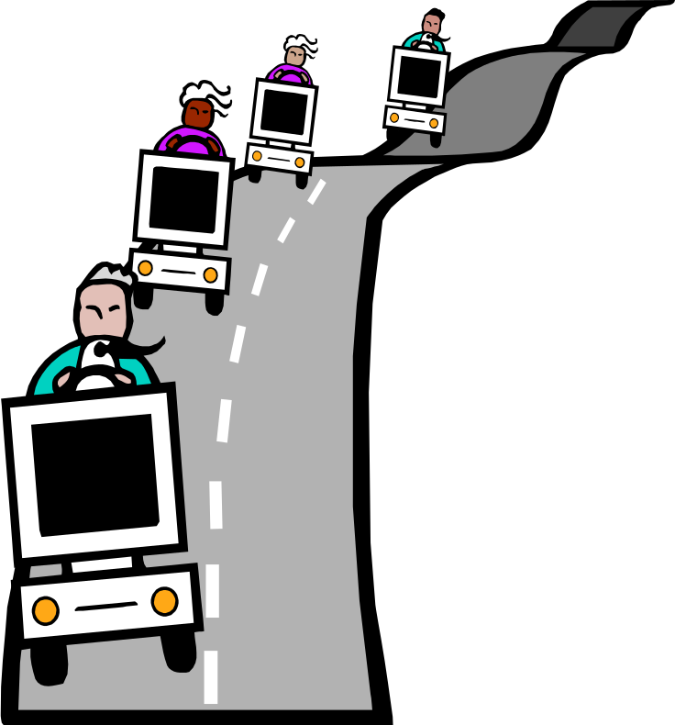
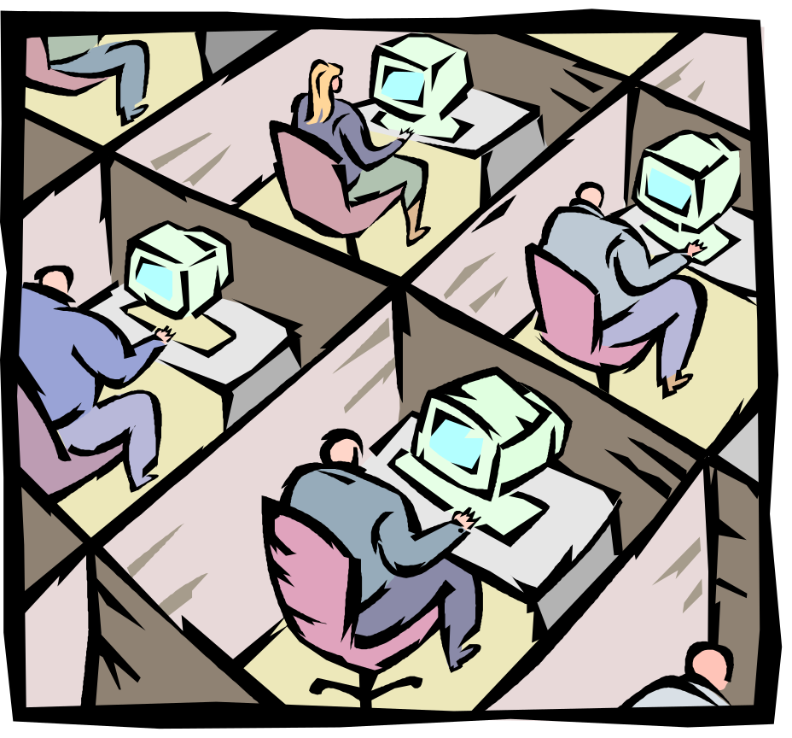
Why Home Networking?

Slide 24
IPv6 Home Networking Example
In IPv4
  Get single IPv4 address from provider
  May need to configure all devices :
    Private address
    Default gateway
  Setup and configure NAT/router
    Address mappings
    Application Layer Gateways (ALGs)
    Needs global IPv4 address from provider

Slide 25
IPv6 Home Networking Example
In IPv6
  Get IPv6 prefix from provider
  Add prefix to gateway/router

